Slide 1

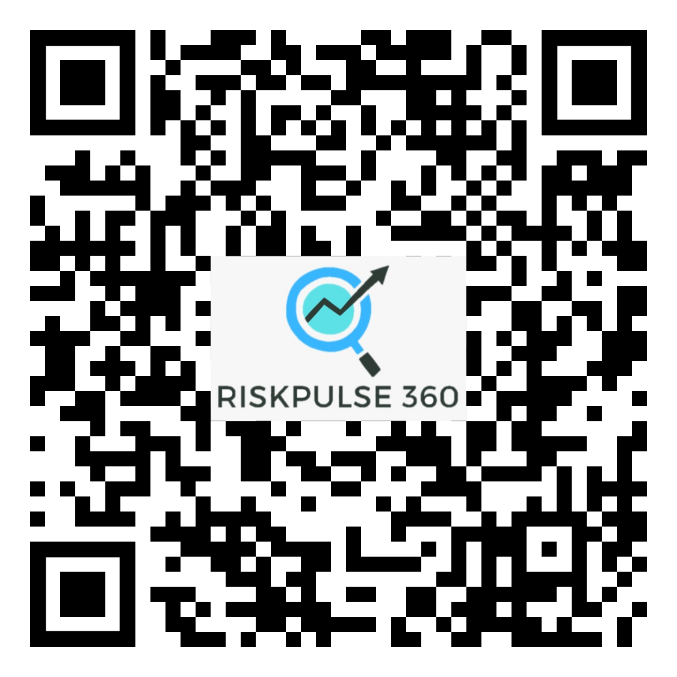

Slide 2
Team behind RiskPulse 360
Omika Shrivastava
13+ years experience in financial services across varied products
Goloknath Mishra
14+ years experience in Digital Transformation using Microsoft Tech.
Arpitha S Shet
CA,4+ experience in Audit /Taxation and currently working as a financial Analyst
Monish Parekh
11+ years experience in Fintech Industry
Komal Tiwari
5+ years experience in Banking Industry
Deepika Jude
13+ years experience in Fintech Industry

Slide 3

Customer service is the core of the customer experience
Customer experience

Slide 4
Customer service is the core of the customer experience
Customer service
Customer experience

Slide 5
Customer service is a high-stakes game
96%
of consumers will leave without warning due to poor service¹
84%
of consumers say personalized service is important to win their business²
76%
Of consumer expect companies to understand their needs and expectations²
¹ Forbes

Slide 6
96%
of customers will leave without warning due to poor customer service¹
¹ Shep Hyken blog, Guest post, 2022

Slide 7


Customers expect exceptional service
But service organizations are not equipped to provide this service
80%
55%
of service organizations do not have collaboration tools to resolve customer issues faster³
of customers expect personalized customer experience¹
110%
More likely to add additional items to their baskets and 40% more likely to spend more than they had planned when the shopping experience was highly personalized²
53%
of agents do not have proper visibility of information to understand the customer context³
¹ Forbes, 50 Stats Showing the Power of Personalization, 2020
² PCG Next Level of Personalization in Retail, 2019
³ Forbes, 50 Stats That Prove the Value of Customer Experience, 2019

Slide 8




Problem Statement
The intricate nature of scattered ,voluminous and non standardized data complicates manual sourcing and analysis
Lack of quantified risk and behavioral indicators coupled with delayed evaluation pose significant risks
Absence of sophisticated tool in market pertaining to data aggregation creating a notable gap
Lack of industry specific risk assessment with in a comprehensive 360-degree framework

Slide 9





End-to-End Service Offerings
RiskShield 360
Effective risk management solution which scans through multiple sources to identify red flags
RiskScore 360
Score Based monitoring and default prediction system that operates based on automated scores
RiskPulse 360
Industry 360
Leveraging current offerings to build a sophisticated solution targeting different industries
RiskUnify 360
Development and Implementation of advanced solution tailored to meet specialized requirements

Slide 10
Services offered in the product segments
Risk Shield 360
Risk Score 360
Negative Scan Checks
Litigation Checks
Tracking Beneficial Ownership
Data Analytics & Dashboards
Predictive Technology Implementation
Intelligent Risk Categorization
Automated Data Collection
Daily Risk quotient
Data Analytics & Dashboards
RiskPulse 360
Industry 360
Risk Unify 360
Banking
Insurance
Investment Management
Securities and Exchange
Fintech
Private Equity & venture Capital
Real Estate
Comparison Aggregators
Financial Data Aggregators
Investment Aggregators
Crowdfunding aggregators
Credit Score Aggregators
Data Analytics & Dashboards

Slide 11



RiskPulse 360
https://riskpulse360.crm.dynamics.com
The most comprehensive platform to safeguard from all counter-party risks
Riskshield360
Comprehensive risk assessment
RiskScore360
Score based risk valuation
RiskUnify360
Unified information for aggregation

Slide 12




















Risk Pulse Platform
Risk Pulse Platform
Microsoft 365
Dynamics 365
Seamless integration architecture with lowest TCO
Highest user satisfaction and always on latest version
Hassle-free IT administration with focus on Innovation
Developer Tools
Power Platform
Power BI
Power Apps
Power Automate
Power Virtual Agent
Microsoft Azure
Data connectors
AI Builder
Identity, security, management, and compliance

Slide 13



Risk Pulse Platform
Microsoft 365
Dynamics 365
AI as a real-time collaborator
…that generates content
…that sparks creativity
…that completes work
Era of Copilots
Developer Tools
Power Platform
Power BI
Power Apps
Power Automate
Power Virtual Agent
Microsoft Azure
Data connectors
AI Builder
Identity, security, management, and compliance

Slide 14

















Solution Architecture
End Users
Authentication
RiskPulse 360
RiskShield 360
RiskScore 360
Industry 360
Integrations
RiskPulse User
Reports
RiskUnify 360
Dashboard
Dataverse
Azure Cloud
N.B : Security Reference - https://servicetrust.microsoft.com/

Slide 15

Target Customers
Banking Sector
Large and Medium NBFC’s
Credit Card Companies
Payment Aggregators

Slide 16
Market Research

Slide 17
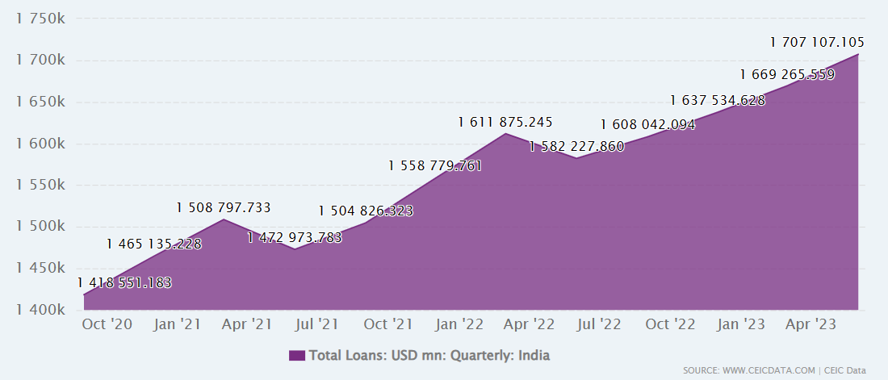
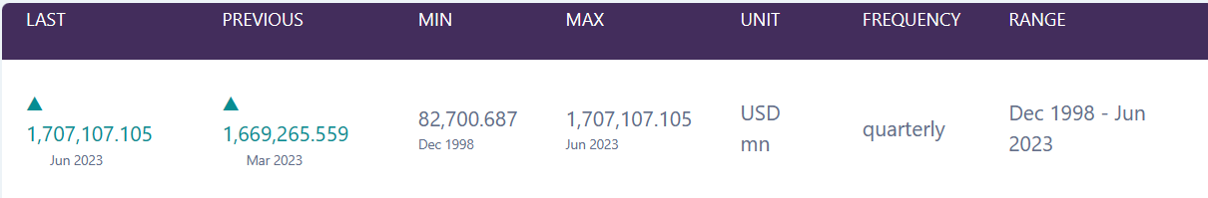
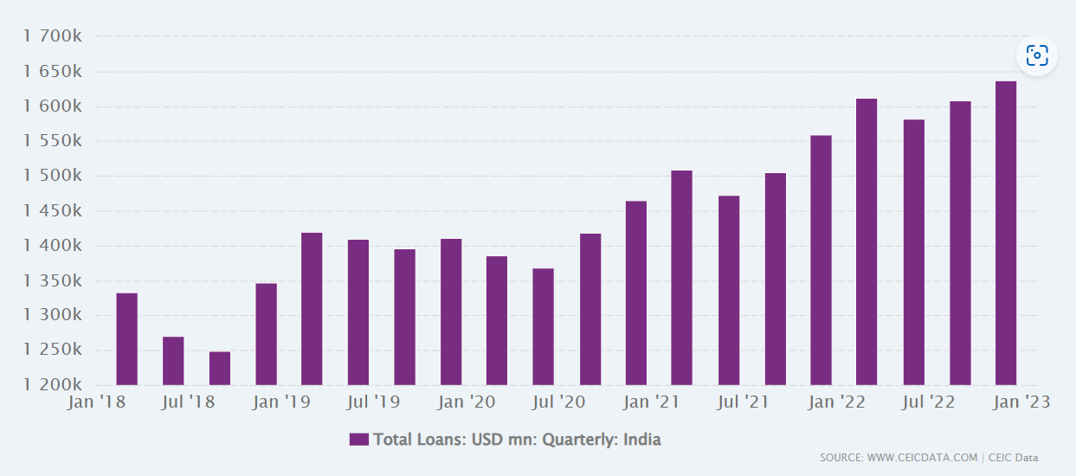
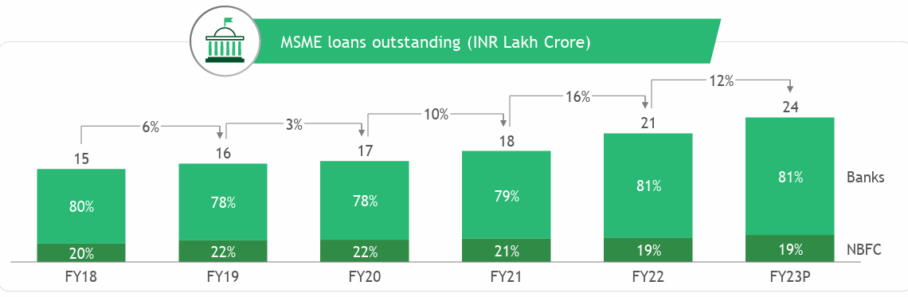
Loan Trends in India..
India Total Loans was reported at 1,707.107 USD bn in Jun 2023¹
This records an increase from the previous number of 1,669.266 USD bn for Mar 2023
^{1 CEIC India Total Loans}

Slide 18
RiskShield 360

Slide 19
Negative scan checks
Litigation checks
Monitoring comprehensive coverage of courts
Tracking case calendar, new cases filed against the organization
Tracking Beneficial Ownership
Identifying Significant and Ultimate Beneficial Owners (SBOs and UBOs)
Data Matching and Deduplication
Document Clustering
Network Analysis
Identifying
Finding Civil or Criminal Cases
Dashboard
Defaulters
Fraudsters
Hawala Entities
Debarred Entities
Regulatory actions, etc.
Graph Analysis
Notes:
Negative Scan checks → Identifying Defaulters, Fraudsters, Hawala Entities, Debarred Entities, Regulatory actions, etc. Finding Civil or Criminal Cases including insolvency and section 138 cases
Real-time monitoring of negative news around entities through a comprehensive dashboard. Monitoring of negative news around entity with a daily newsletter containing the most relevant article.
Litigation Checks → Monitoring comprehensive coverage of courts across India and high update frequency makes us the ideal platform for your monitoring needs
Tracking case calendar, new cases filed against the organization, and relevant orders and judgments
Tracking Beneficial Ownership →
Identifying Significant and Ultimate Beneficial Owners (SBOs and UBOs) is crucial for various industries, especially in finance and businesses subject to anti-money laundering (AML) and know your customer (KYC) regulations. Implementing efficient algorithms can help reduce costs and time spent on this process. Here are several algorithms and approaches that can be employed
Graph Analysis
Data Matching and Deduplication
Document Clustering
Network Analysis

Slide 20
Income Insights Pro
Verify 360
This system efficiently extracts and reconciles data from diverse sources, including bank statements and various income documents like Payslips, ITR forms, ITR-V, and Form 16, sourced from both online and offline channels.
It shall highlight outliers and anomalies in data thus generating valuable insights which are otherwise invisible /difficult to gauge while scanning large volumes of data.
This involves assessing the creditworthiness of individuals or entities applying for loans.
This process helps lenders make informed decisions regarding whether to approve or deny a credit application on the basis of customers Credit Rating , existing borrowings, repayment pattern etc.

Slide 21
RiskUnify 360

Slide 22
Comparison Aggregator
Financial Aggregator
Credit score Aggregator
Investment Aggregator
Crowdfunding Aggregator
N.B – This list is not comprehensive which can be expanded to more industry segments

Slide 23
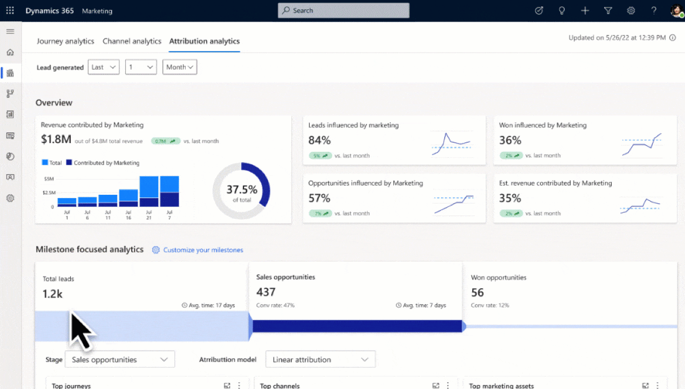

Slide 24
RiskScore 360

Slide 25
Predictive Technology Implementation: Leverages exclusive predictive technology to proactively identify companies in the portfolio with escalating risk, streamlining the credit decision-making process.
Intelligent Risk Categorization: It categorizes risk basis 60+parameters deriving from over 100 data points (which is updated basis verified sources), delivering a precise and reliable indication of the level of risk associated.
Automated Data Collection: Automatically gathers data and information from numerous reliable sources for both listed and unlisted Indian companies, ensuring comprehensive coverage.
Daily Risk Quotient (RQ) Generation: Analyzes collected data to generate a daily Risk Quotient (RQ) for each company in the portfolio, allowing for up-to-date risk assessments.

Slide 26
Input
Upload Data
Compute Score
Algorithm shall compute score basis multiple data points
Output
Basis Risk score generated dashboard can be prepared

Slide 27
Sources of Information
Registrar of Companies.
Media and Press Archives
MCA Website/ Advanced Google Checks/Commercial Tax Website
Income Tax Department/EPFO/Goods and Service Tax Website/Voter’s Service Portal(Electoral Searches)
Watch Lists
Lexis/Nexis
Watch Out Investors
Case status Website
Credit Information Bureau of India Limited (CIBIL)
SEBI
Central Board of Excise and Customs Websites
OFAC
World Compliance Refinitiv
Internet Search Engines and Meta Search engines
N.B – Above List is not exhaustive in nature and is mentioned only for reference.

Slide 28
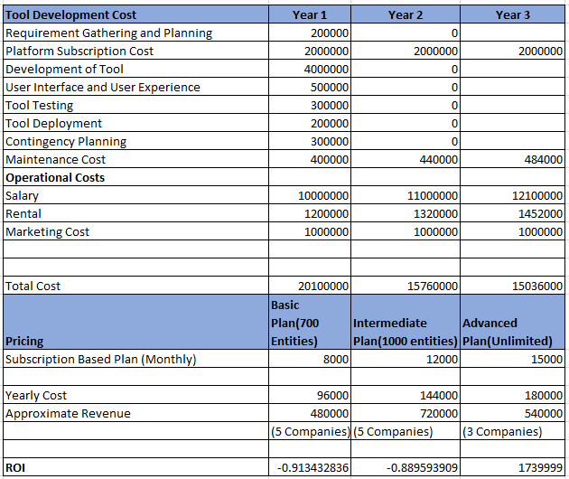
Return on Investment(ROI)
N.B – The pricing model is for our product RiskScore360

Slide 29
VRIN Framework
Determine Rarity:
Comprehensive Database, Centralized Data Platform, Intelligent Data Analysis Tool:
Assessment: These are relatively rare, offering a comprehensive and integrated solution not commonly found in the market.
Proprietary Algorithms (Beneficial Ownership Trace, Early Warning Signals, Litigation BI Filtering):
Assessment: These algorithms are unique and specialized, contributing to the rarity of the overall offering.. Exclusive ownership of these algorithms give them an edge
Examine Inimitability:
Comprehensive Database, Network Graph Analysis, Proprietary Algorithms:
Assessment: The complexity and expertise required to replicate these resources make them difficult to imitate, providing a sustainable advantage.
Litigation Monitoring, Negative News Monitoring:
Assessment: The continuous monitoring capabilities are challenging to replicate, contributing to a sustained competitive advantage.
Evaluate Non-substitutability:
Assessment: These resources are difficult to substitute as they offer a unique set of tools and algorithms tailored for comprehensive due diligence and risk assessment.
Assess Evaluability:
Comprehensive Database, Centralized Data Platform, Intelligent Data Analysis Tool:
Assessment: These resources add substantial value by offering a comprehensive solution for data management, organization, and intelligent analysis.
Litigation Monitoring, Negative News Monitoring:
Assessment: These resources contribute to improved decision-making by providing real-time insights into legal and reputational aspects, enhancing their value.
Proprietary Algorithms (Early Warning Signals, BI Filtering):
Assessment: These algorithms enhance the accuracy and value proposition by providing focused and critical information, aiding in better decisioning

Slide 30
Success factors
Expert advisory and guidance to lenders, providing them with necessary information to make informed decisions
The market isn't fully developed, therefore being first could provide us an advantage
Consolidate diverse investment options onto a single platform to minimize risk
Profile end to end platform to service providers

Slide 31
Way Forward..
Industry Diversification/New Technologies
Greater use of copilot capability including loyalty & customer lifetime value
Provide end to end solution including customer service platform with Geo Tag
Industry connect facilitation
Customer Engagement and Talent Acquisitions
Strategic Partnerships

Slide 32
